Slide 1
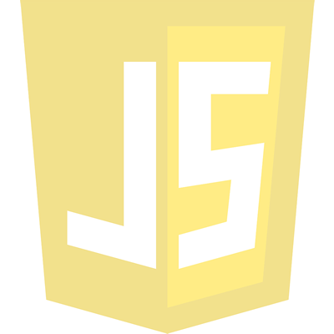

CIT 261
Mobile Development
Loops
Conditional statements
Functions
Variables
Parameters
Arrays
Associative Arrays
by Rafael Ferraz

Slide 2

Loops

Slide 3
Loops
Loops can execute a block of code a number of times.
Instead of writing:
text += cars[0] + "<br>"; text += cars[1] + "<br>"; text += cars[2] + "<br>"; text += cars[3] + "<br>"; text += cars[4] + "<br>"; text += cars[5] + "<br>";
You can write:
for (i = 0; i < cars.length; i++) { text += cars[i] + "<br>"; }

Slide 4
For - Loop
The for loop is often the tool you will use when you want to create a loop.
for (statement 1; statement 2; statement 3) { code block to be executed }
Statement 1 is executed before the loop (the code block) starts.
Statement 2 defines the condition for running the loop (the code block).
Statement 3 is executed each time after the loop (the code block) has been executed.
}

Slide 5
For - Loop
The for loop is often the tool you will use when you want to create a loop.
var i = 0;
for (i = 0; i < 5; i++) { text += "The number is " + i + "<br>"; }
Statement 1 Normally you will use statement 1 to initialize the variable used in the loop (i = 0)..
Statement 2 Often statement 2 is used to evaluate the condition of the initial variable.
Statement 3 Often statement 3 increments the value of the initial variable.

Slide 6
For - Loop
The for loop is often the tool you will use when you want to create a loop.
for (i = 0; i < 5; i++) { text += "The number is " + i + "<br>"; }
The number is 0 The number is 1 The number is 2 The number is 3 The number is 4

Slide 7
While - Loop
The while loop loops through a block of code as long as a specified condition is true.
while (condition) { code block to be executed }

Slide 8
While - Loop
The while loop loops through a block of code as long as a specified condition is true.
The number is 0
The number is 1
The number is 2
The number is 3
The number is 4
The number is 5
The number is 6
The number is 7
The number is 8
The number is 9
while (i < 10) { text += "The number is " + i; i++; }

Slide 9
While - Loop
The while loop loops through a block of code as long as a specified condition is true.
The number is 0
The number is 1
The number is 2
The number is 3
The number is 4
The number is 5
The number is 6
The number is 7
The number is 8
The number is 9
while (i < 10) { text += "The number is " + i; i++; }

Slide 10
Do/While - Loop
The do/while loop is a variant of the while loop. This loop will execute the code block once, before checking if the condition is true, then it will repeat the loop as long as the condition is true.
do { code block to be executed } while (condition);

Slide 11
Do/While - Loop
The do/while loop is a variant of the while loop. This loop will execute the code block once, before checking if the condition is true, then it will repeat the loop as long as the condition is true.
The number is 0
The number is 1
The number is 2
The number is 3
The number is 4
The number is 5
The number is 6
The number is 7
The number is 8
The number is 9
do { text += "The number is " + i; i++; } while (i < 10);

Slide 12
Do/While - Loop
The do/while loop is a variant of the while loop. This loop will execute the code block once, before checking if the condition is true, then it will repeat the loop as long as the condition is true.
The number is 0
The number is 1
The number is 2
The number is 3
The number is 4
The number is 5
The number is 6
The number is 7
The number is 8
The number is 9
do { text += "The number is " + i; i++; } while (i < 10);

Slide 13

Conditional Statements

Slide 14
The if Statement
Use the if statement to specify a block of JavaScript code to be executed if a condition is true.
if (condition) { block of code to be executed if the condition is true }

Slide 15
The if Statement
Use the if statement to specify a block of JavaScript code to be executed if a condition is true.
if (hour < 18) { greeting = "Good day"; }

Slide 16
The else Statement
Use the else statement to specify a block of code to be executed if the condition is false.
if (condition) { block of code to be executed if the condition is true } else { block of code to be executed if the condition is false }

Slide 17
The else Statement
Use the else statement to specify a block of code to be executed if the condition is false.
if (hour < 18) { greeting = "Good day"; } else { greeting = "Good evening"; }

Slide 18
The else if Statement
Use the else if statement to specify a new condition if the first condition is false.
if (condition1) { block of code to be executed if condition1 is true } else if (condition2) { block of code to be executed if the condition1 is false and condition2 is true } else { block of code to be executed if the condition1 is false and condition2 is false }

Slide 19
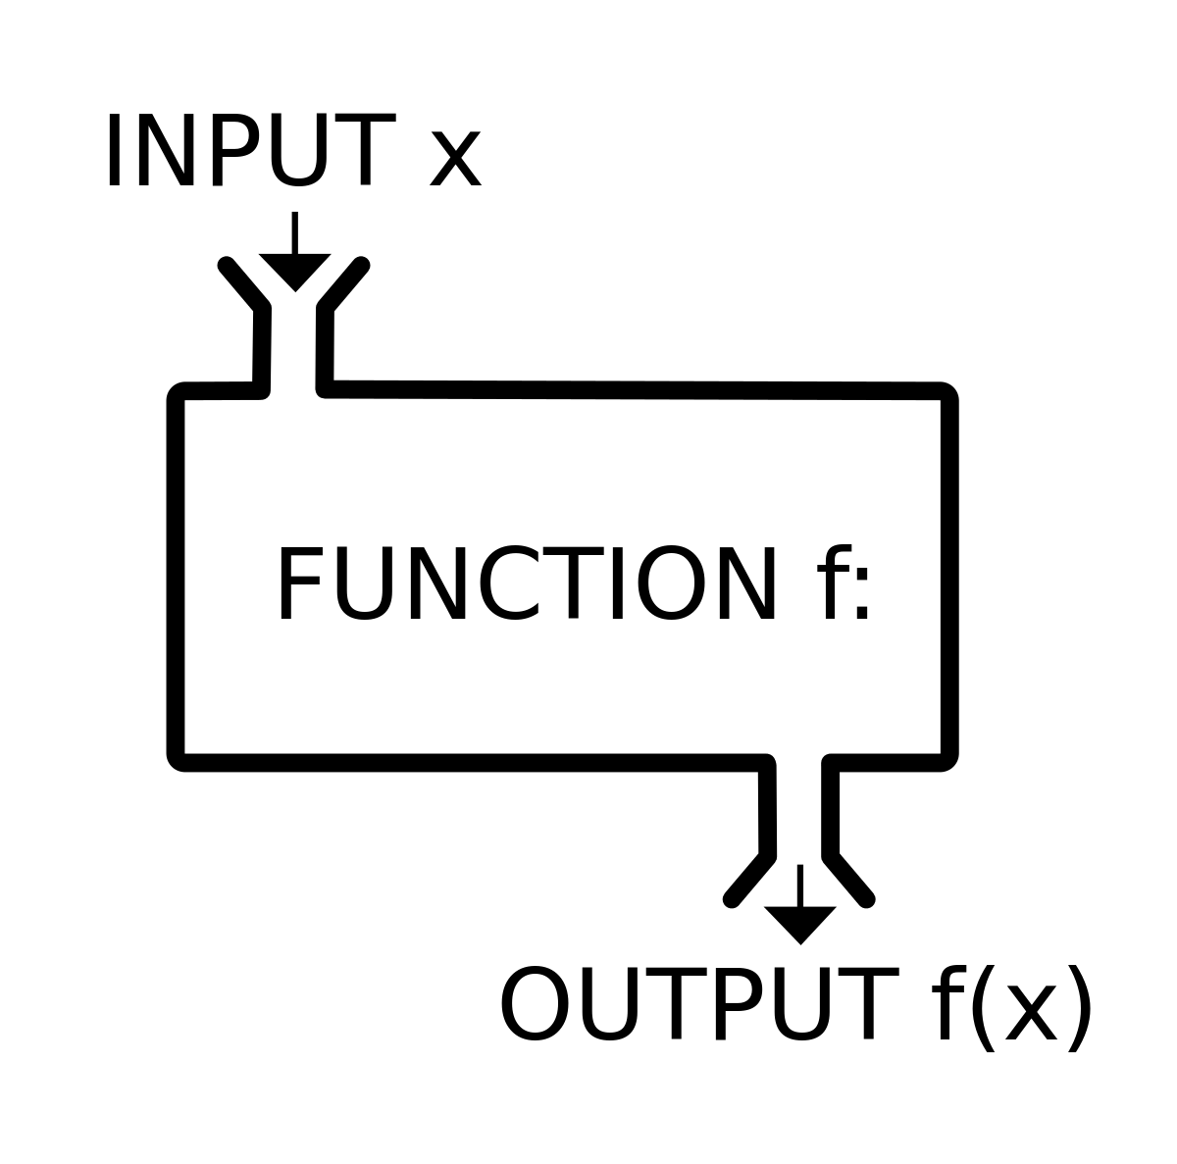
Functions

Slide 20
Functions
A JavaScript function is a block of code designed to perform a particular task.
A JavaScript function is executed when "something" invokes it (calls it).
function myFunction (p1, p2) { return p1 * p2; // The function returns the product of p1 and p2 }

Slide 21
Functions
A JavaScript function is defined with the function keyword, followed by a name, followed by parentheses ().
Function names can contain letters, digits, underscores, and dollar signs (same rules as variables).
The parentheses may include parameter names separated by commas: (parameter1, parameter2, ...)
The code to be executed, by the function, is placed inside curly brackets: {}

Slide 22

Function Invocation
The code inside the function will execute when "something" invokes (calls) the function:
When an event occurs (when a user clicks a button)
When it is invoked (called) from JavaScript code
Automatically (self invoked)
function myFunction (p1, p2) { return p1 * p2; // The function returns the product of p1 and p2 }
var value = myFunction(1, 5);

Slide 23
Function Return
When JavaScript reaches a return statement, the function will stop executing.
If the function was invoked from a statement, JavaScript will "return" to execute the code after the invoking statement.
Functions often compute a return value. The return value is "returned" back to the "caller"
12
var x = myFunction(4, 3); // Function is called, return value will end up in x function myFunction(a, b) { return a * b; // Function returns the product of a and b }

Slide 24

Why functions?
You can reuse code: Define the code once, and use it many times.
You can use the same code many times with different arguments, to produce different results.

Slide 25

Variables

Slide 26
Variables
JavaScript variables are containers for storing data values.
var price1 = 5; var price2 = 6; var total = price1 + price2;
Names can contain letters, digits, underscores, and dollar signs.
Names must begin with a letter
Names can also begin with $ and _
Names are case sensitive (y and Y are different variables)
Reserved words (like JavaScript keywords) cannot be used as names

Slide 27
Keywords Let and Const
ES6
`const` is a signal that the identifier won’t be reassigned.
`let`, is a signal that the variable may be reassigned
for (var i=0; i<5; i++){ text += "The number is " + i; } console.log(i); // 6
for (let i= 0; i<5; i++){ text += "The number is " + i; } console.log(i); // undefined

Slide 28

Parameters

Slide 29
Parameters
Earlier in this tutorial, you learned that functions can have parameters:
functionName(parameter1, parameter2, parameter3) { code to be executed }
If a function is called with missing arguments (less than declared), the missing values are set to: undefined
function myFunction(x, y) { if (y === undefined) { y = 0; } }

Slide 30
Parameters
Arguments are Passed by Value
The parameters, in a function call, are the function's arguments.
JavaScript arguments are passed by value: The function only gets to know the values, not the argument's locations.
If a function changes an argument's value, it does not change the parameter's original value.
Changes to arguments are not visible (reflected) outside the function.
Objects are Passed by Reference
In JavaScript, object references are values.
Because of this, objects will behave like they are passed by reference:
If a function changes an object property, it changes the original value.
Changes to object properties are visible (reflected) outside the function.

Slide 31

Arrays

Slide 32
Array
An array is a special variable, which can hold more than one value at a time.
var car1 = "Saab"; var car2 = "Volvo"; var car3 = "BMW";
var cars = ["Saab", "Volvo", "BMW"];
Creating an Array...
Access the Elements of an Array…
var array_name = [item1, item2, ...];
var name = cars[0];
var cars = [ "Saab", "Volvo", "BMW" ];
cars[0] = “Chevy";
var cars = new Array("Saab", "Volvo", "BMW");

Slide 33
Arrays are Objects
Arrays are a special type of objects. The typeof operator in JavaScript returns "object" for arrays.
But, JavaScript arrays are best described as arrays.
Arrays use numbers to access its "elements". In this example, person[0] returns John:
var person = ["John", "Doe", 46];

Slide 34
Array Elements Can Be Objects
JavaScript variables can be objects. Arrays are special kinds of objects.
Because of this, you can have variables of different types in the same Array.
You can have objects in an Array. You can have functions in an Array. You can have arrays in an Array:
myArray[0] = Date.now; myArray[1] = myFunction; myArray[2] = myCars;

Slide 35
Associative Array
Associative arrays are dynamic objects that the user redefines as needed.
var arr = { "one": 1, "two": 2, "three": 3 };
Unlike simple arrays, we use curly braces instead of square brackets.
This has implicitly created a variable of type Object.
var y = arr["one"];

Slide 36
Associative Array
An associative array is also an object;
So we can create an associative array with the Object reserved word, then and assign keys and values:
var o = new Object();
o["one"] = 1;
o["two"] = 2;
o["three"] = 3;
for(var i in o) { document.write(i + "=" + o[i] + '<br>'); }
// one=1 // two=2 // three=3

Slide 37
CIT 261
Mobile Development
Loops
Conditional statements
Functions
Variables
Parameters
Arrays
Associative Arrays
THE END!

